Slide 1
This presentation is owned by training-and-consulting.de. All rights reserved. Any distribution or copying of individual content or entire pages is prohibited

Slide 2
What Is a Good Requirement?
Once we understand the stakeholders and the problem, we can write requirements
Characteristics of good requirements:
Atomic | Each requirement shall be a single function or design entity
Solution-independent | Does not impose specific detailed solutions
Complete | Express all relevant aspects
Consistent | Not in contradiction with other requirements
Modular | Can be adapted without excessive impact
Verifiable | It shall be possible to verify that the system meets the requirement
Correct | The requirement is appropriately defined and technically possible.
Clear | The requirement shall not have different interpretation
Traceable | It is possible to trace between requirements at different hierarchical levels.
Feasable | Can be implemented within resource and schedule.

Slide 3
Requirement Basic
Formula:
Unconditional requirement
The <system> shall <process verb> < object>
With precondition
When <condition>, the <system> shall <process verb> < object>
System behavioral over a specific period of time
During <condition>, the <system> shall <process verb> <object>
Event-triggered system response
Upon <event>, the <system> shall <process verb> <object>
Unwanted behavior
The <system> shall not <process verb> <object>
Use of requirements templates

Slide 4
Specification Structure
Introduction
Reference Documents
Definitions
Inputs: are the functional interfaces from diagrams
Outputs: are the functional interfaces from diagrams
Functionality: It shall include all the behaviors of all the outputs of this function/element.
Constraints: The constraint section shall include the non-functional requirements
Diagnostic Monitors
Configuration: It shall include all the configurable aspects of the product
Safety/Security(optional): It shall include the non-functional requirements generated by Safety and Security

Slide 5
Important Attributes
Comment
CustomerID
ImpactedDiscipline
Implemented
Original_Id
ReqStatus
Target
Type
Verification_Criteria

Slide 6
Requirement Abstraction Levels
Requirements Traceability

Slide 7
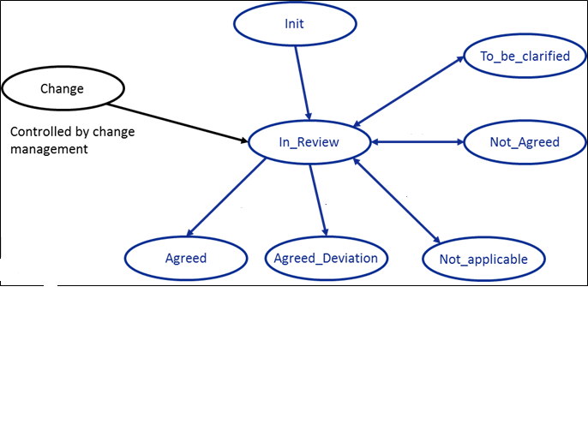
Review Process
Review protocol
Checklist

Slide 8
Metriken von Requirements
Number of Requirements
Number of implemented Requirements
Traceability to Upper Level and Lower Level
Test Coverage
Tested
Test Ok
Test Partialy Ok
Test not Ok

Slide 9
Agenda Item

