Slide 1
This presentation is owned by training-and-consulting.de. All rights reserved. Any distribution or copying of individual content or entire pages is prohibited

Slide 2
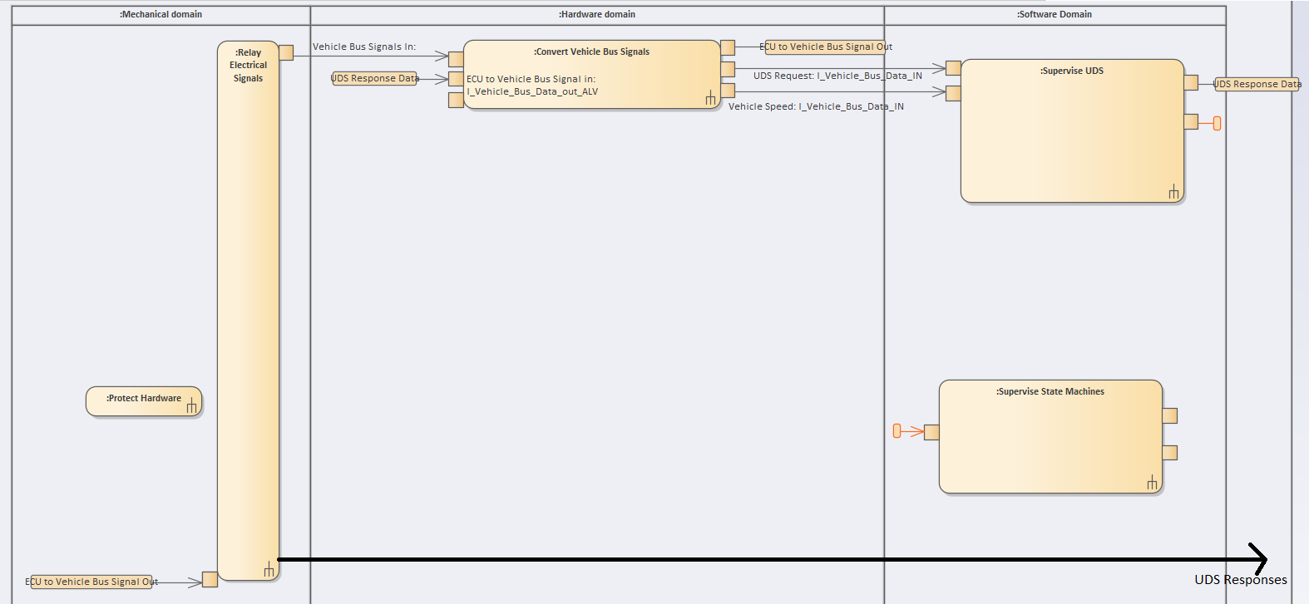
Workflow

Slide 3
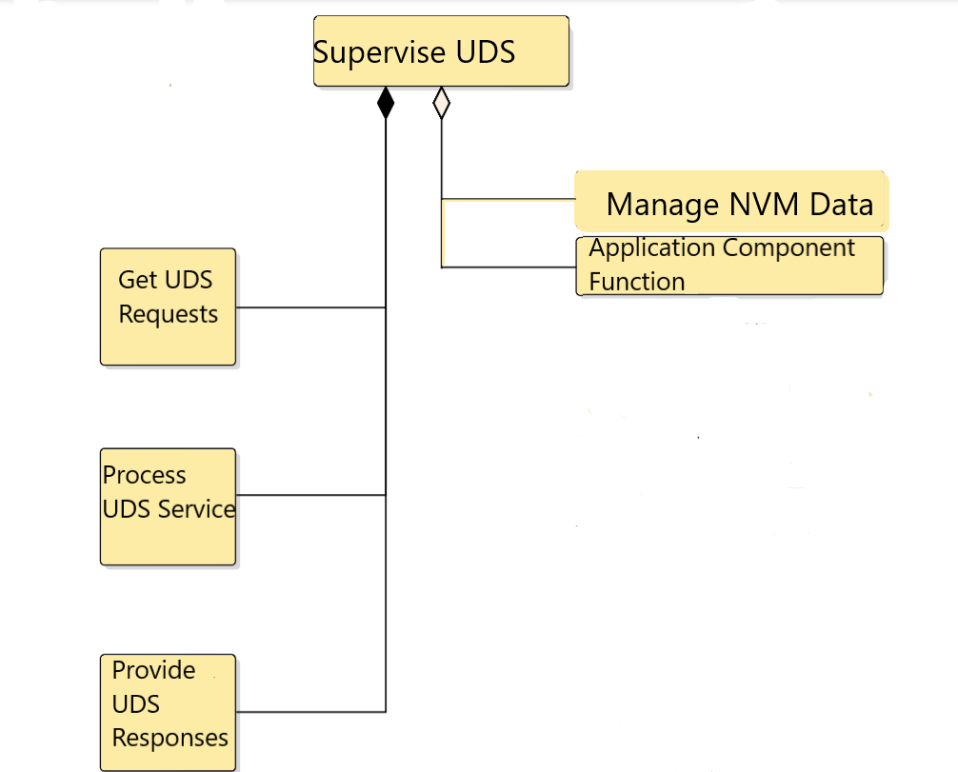
Workflow

Slide 4
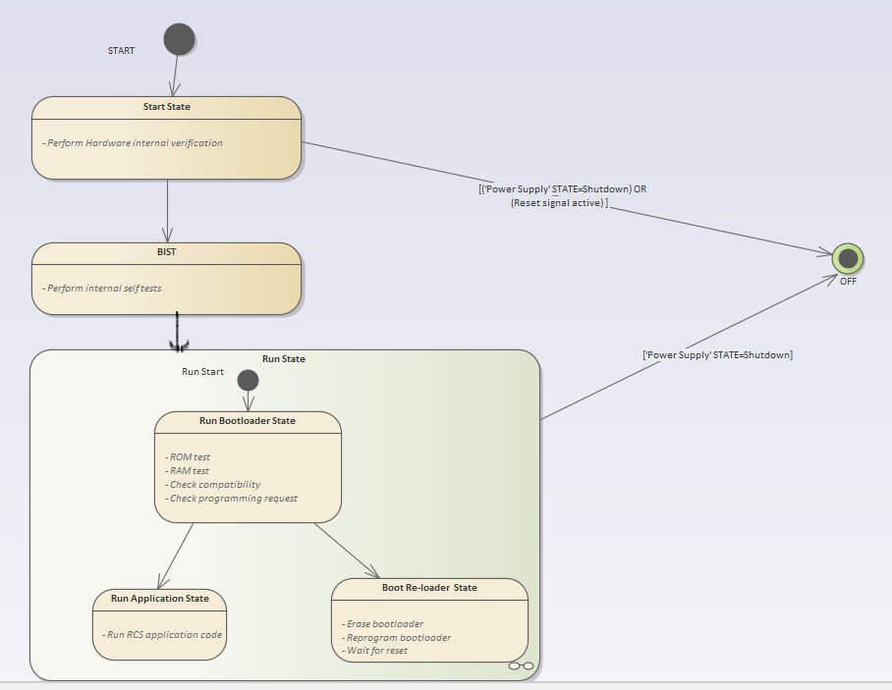
State Diagram

Slide 5
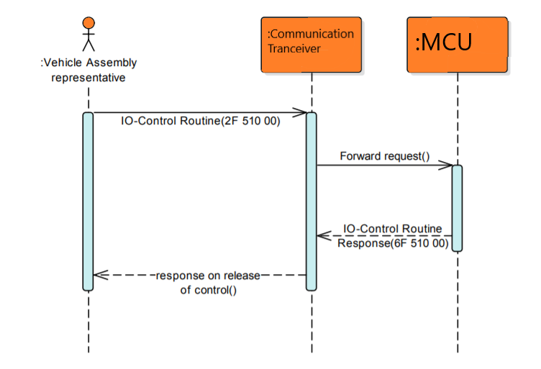
Sequence Diagram

Slide 6
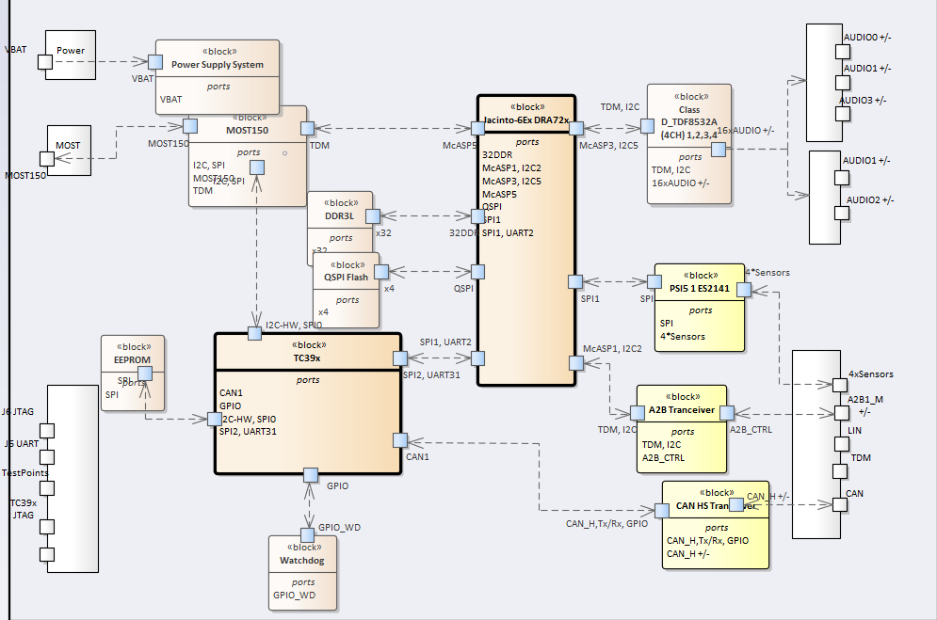
Physical View

